Slide 1
Sample Scoreboards
Collected Fall 2021

Slide 2
Meadowlark Elementary School
Liberal USD 480

Slide 7
Santa Fe Trail Middle School
Olathe USD 233

Slide 9
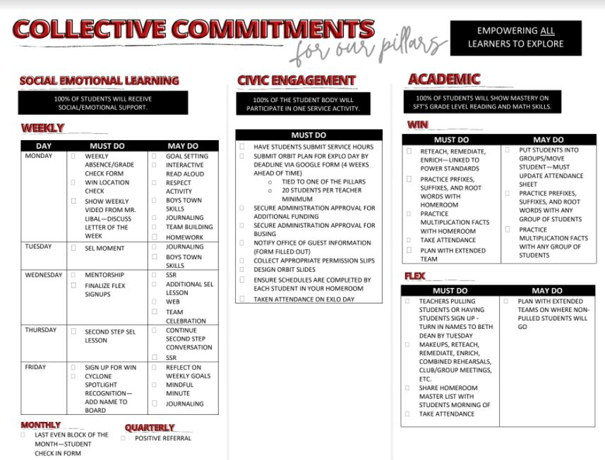

Slide 10
Stockton Grade School
USD 271

Slide 11
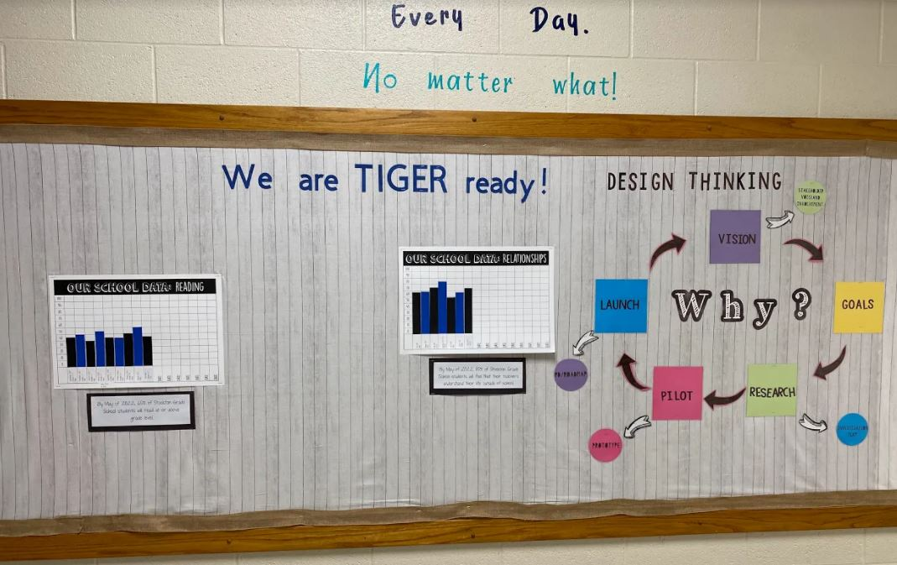

Slide 12
Medicine Lodge Jr/Sr High School
North Barber County USD 254

Slide 13
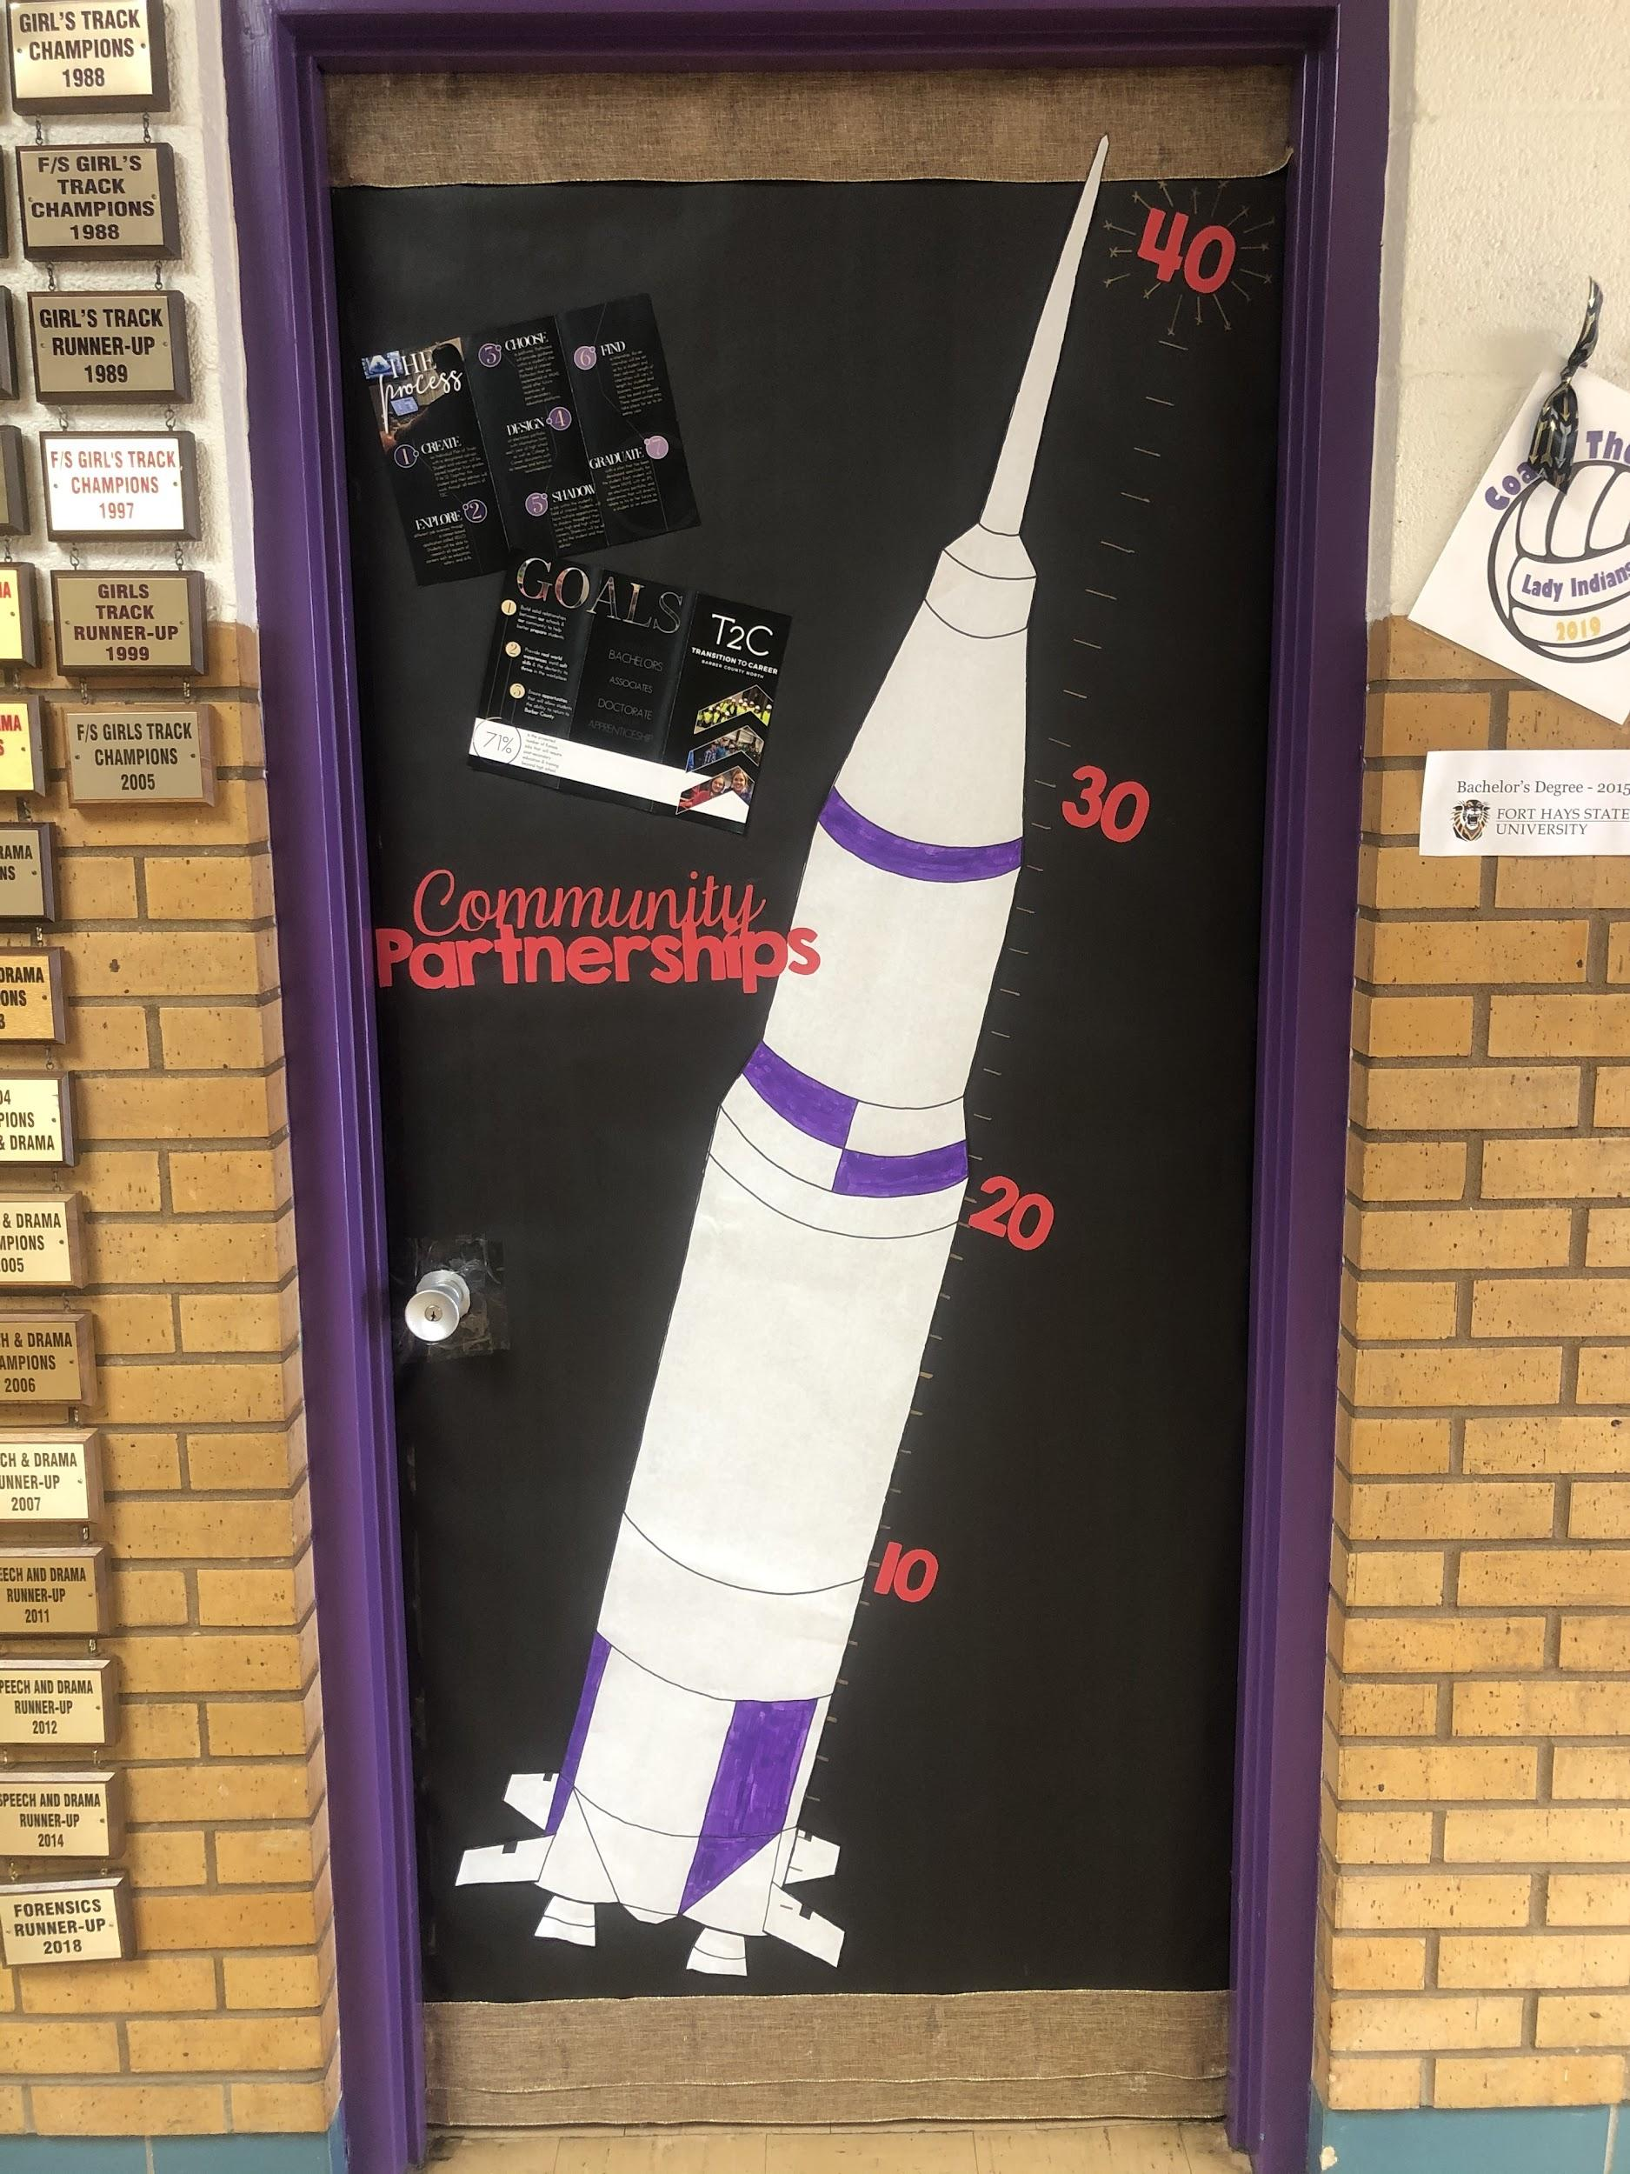
GOAL-
Develop a successful relationship with at least 40 businesses!

Slide 14
Medicine Lodge Grade School (North Barber County USD 254)

Slide 15
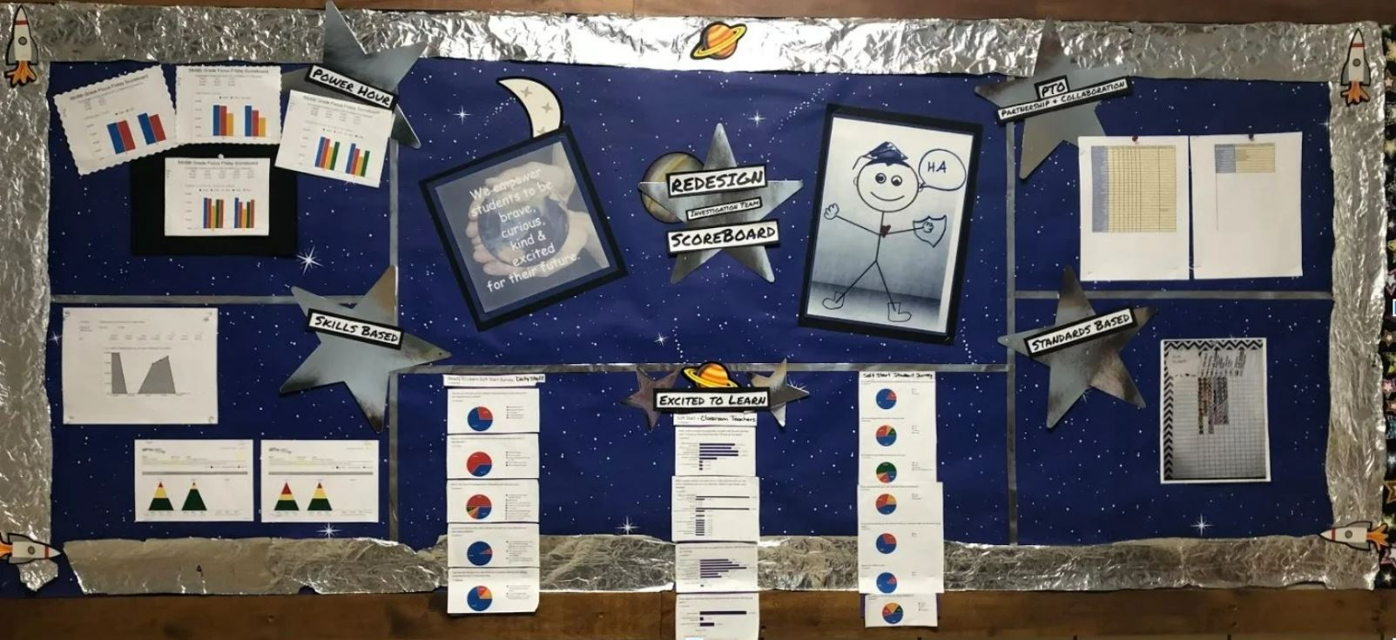

Slide 16
Walnut Elementary
Emporia USD 253

Slide 17
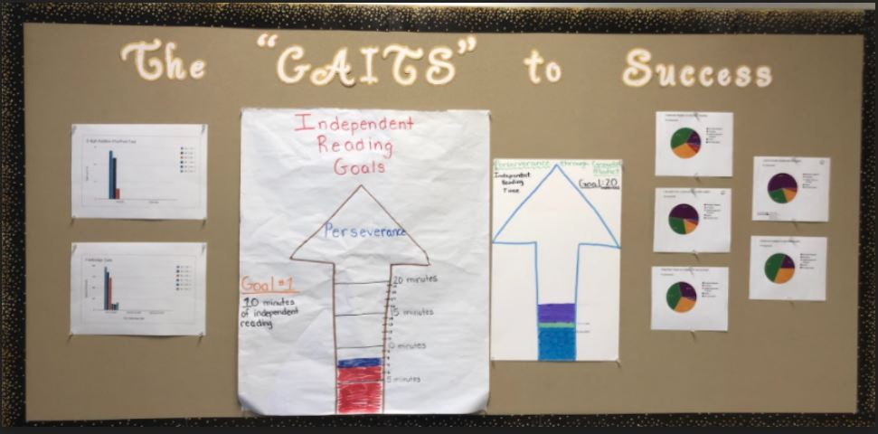

Slide 18
Bentley Primary School USD 440

Slide 19
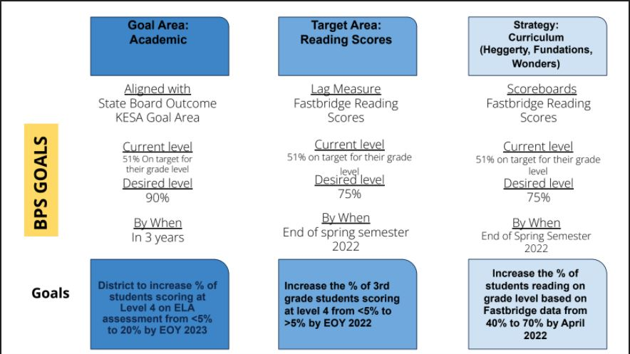

Slide 20
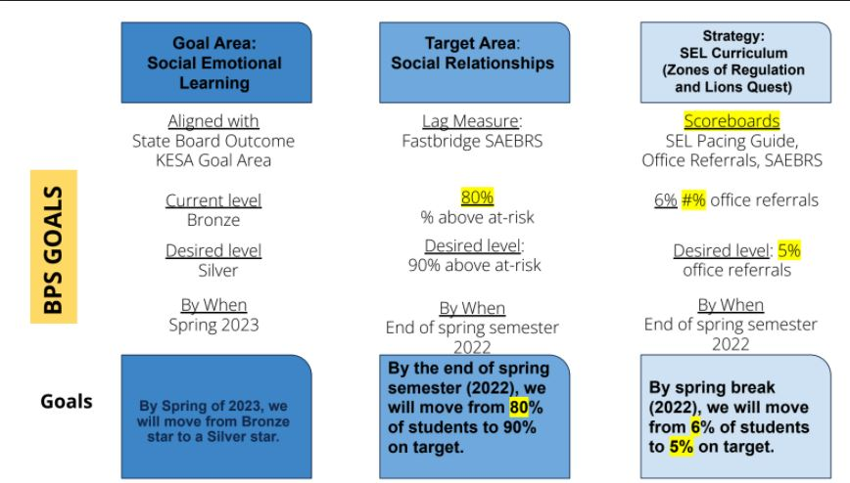

Slide 21
Central Elementary
Lyons USD 405

Slide 22
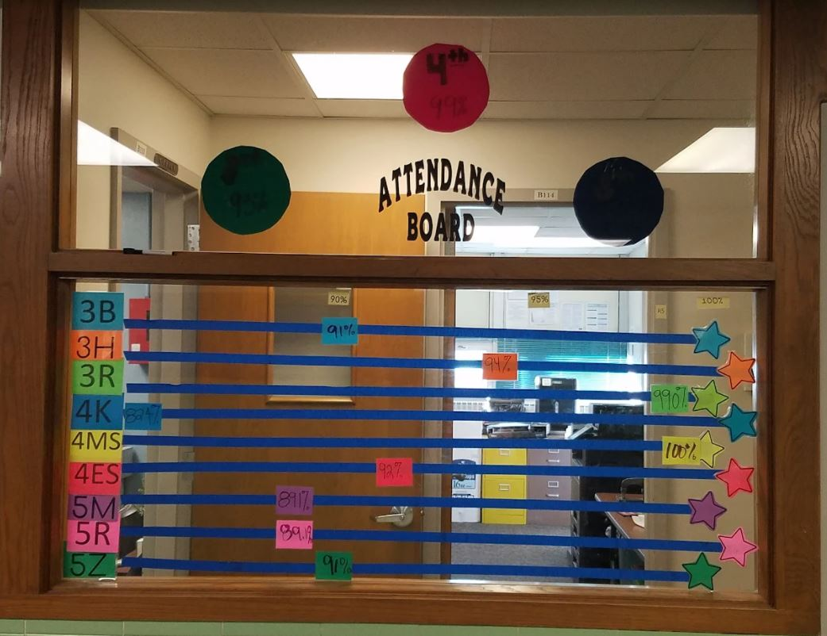

Slide 23
Overbrook Attendance Center
USD 434

Slide 24
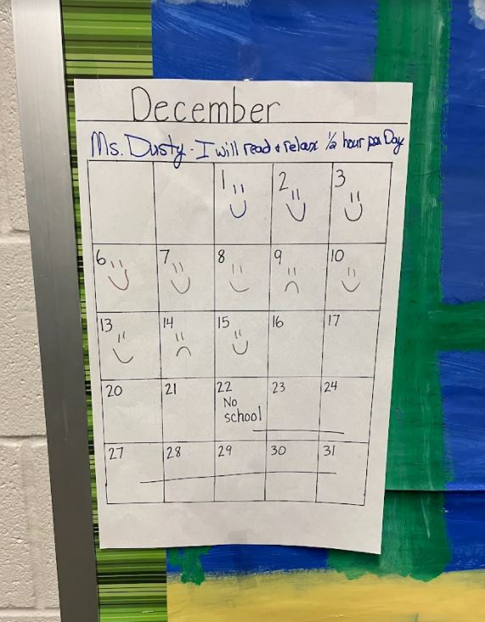

Slide 25
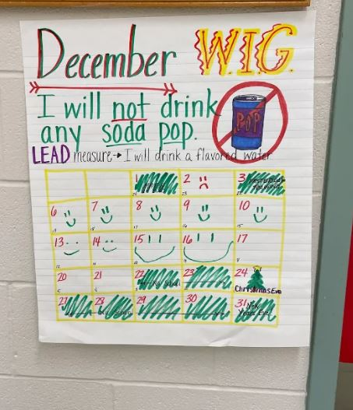

Slide 26
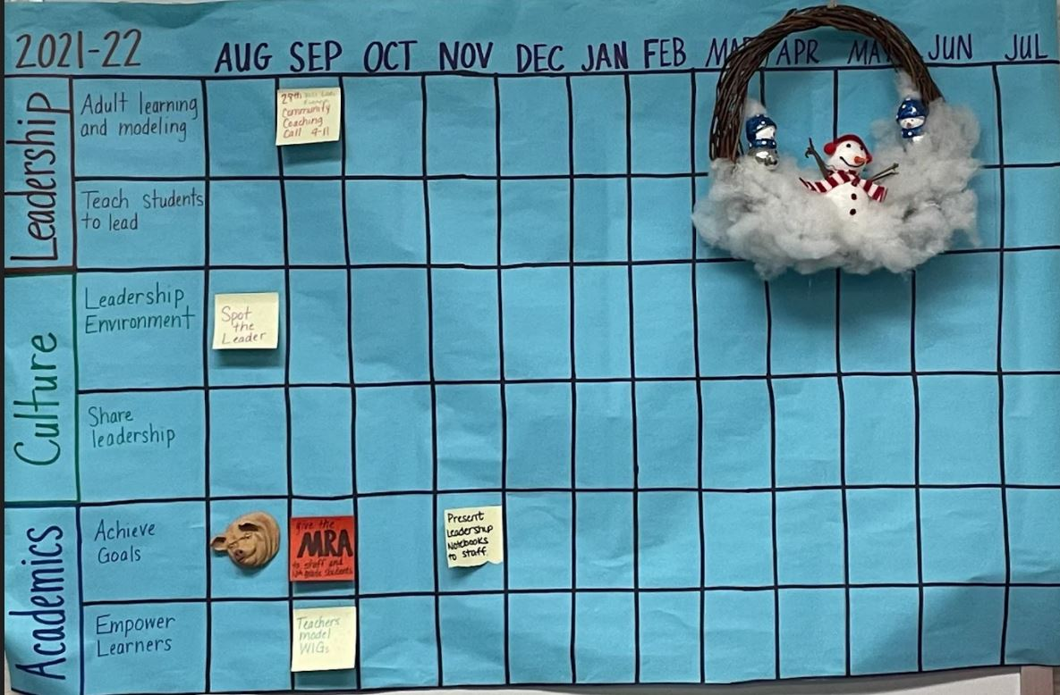

Slide 27
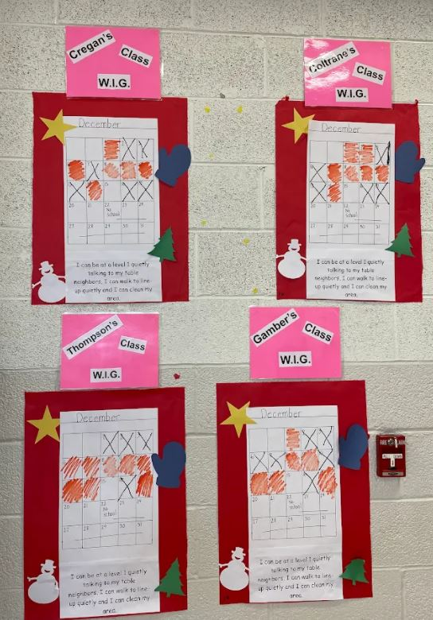

Slide 28
Park Elementary
Lyons USD 405

Slide 29
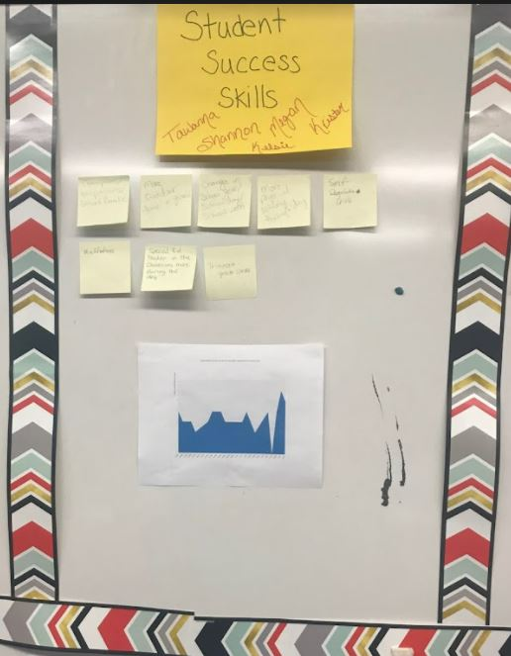

Slide 30
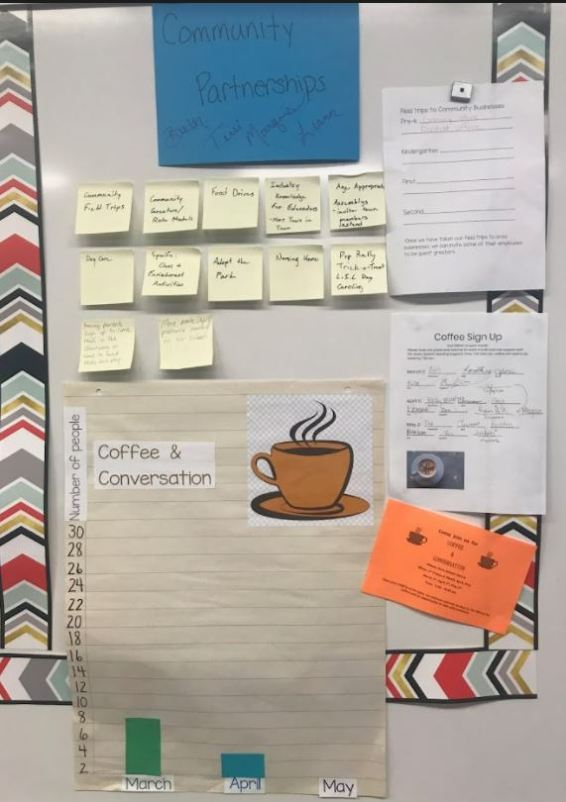

Slide 31
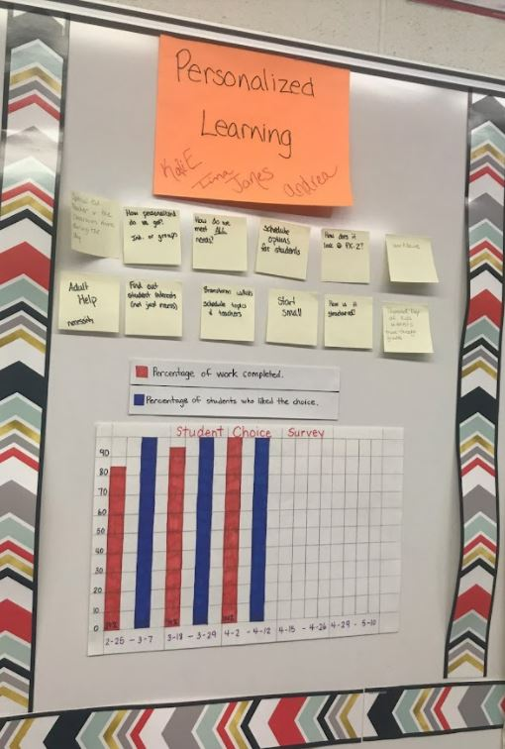

Slide 32
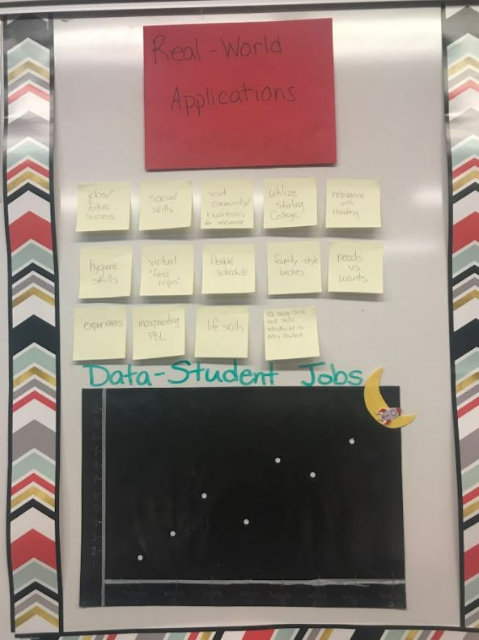

Slide 33
Fowler USD 225

Slide 34
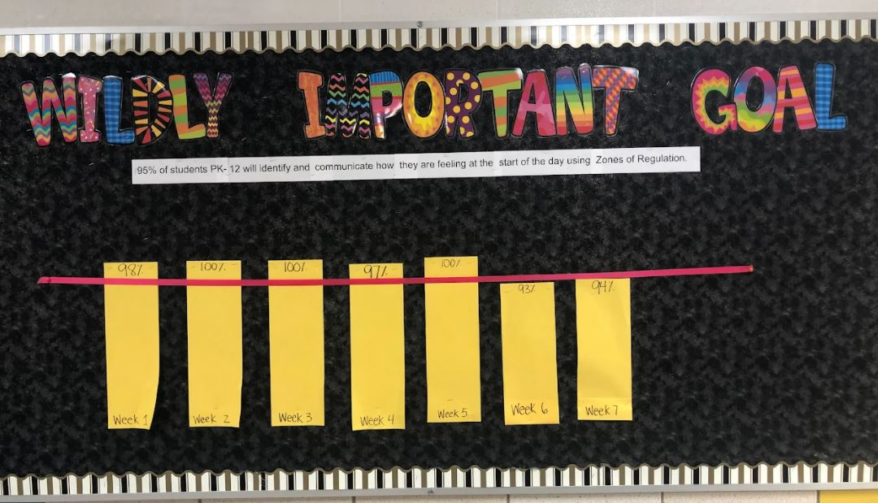

Slide 35
North Elementary
Goodland USD 352

Slide 36
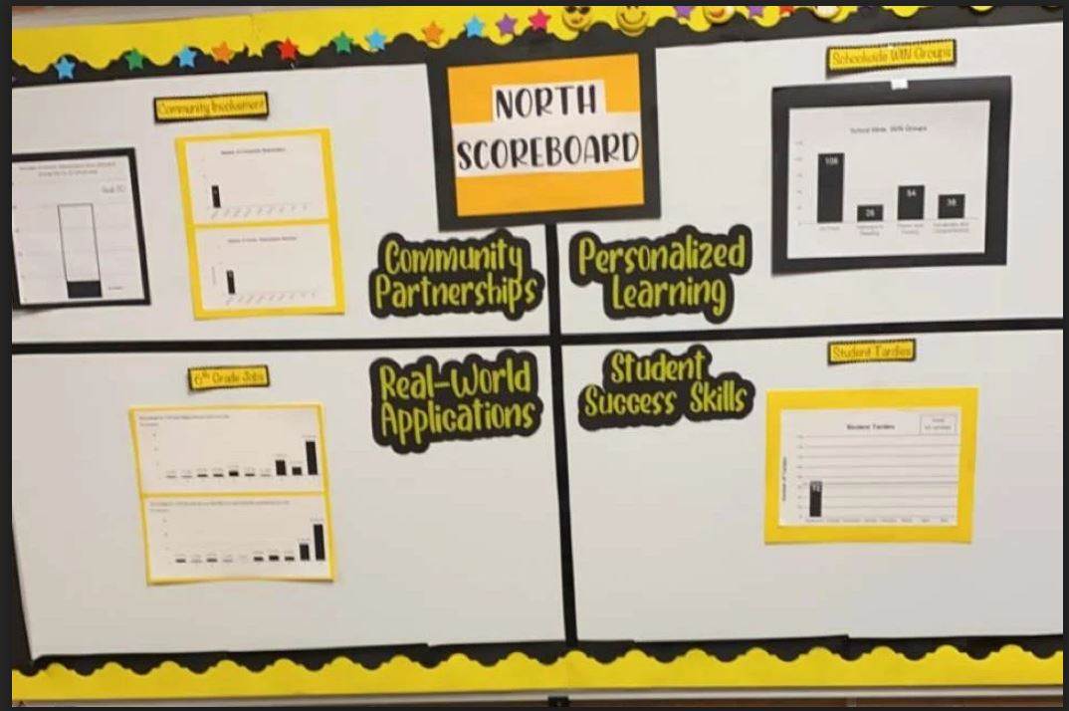

Slide 37
Wiley Elementary School
Hutchinson USD 308

Slide 38
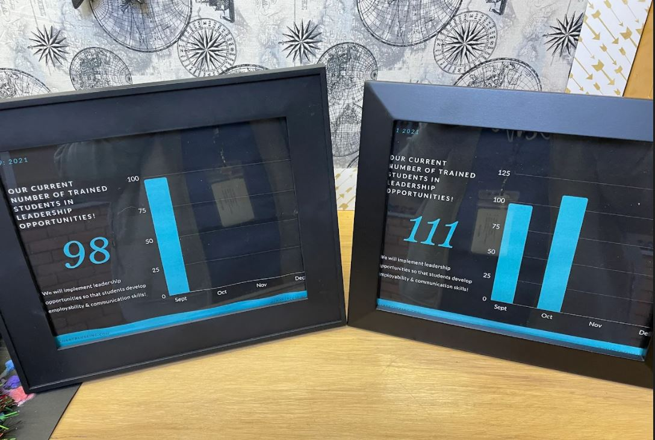

Slide 39
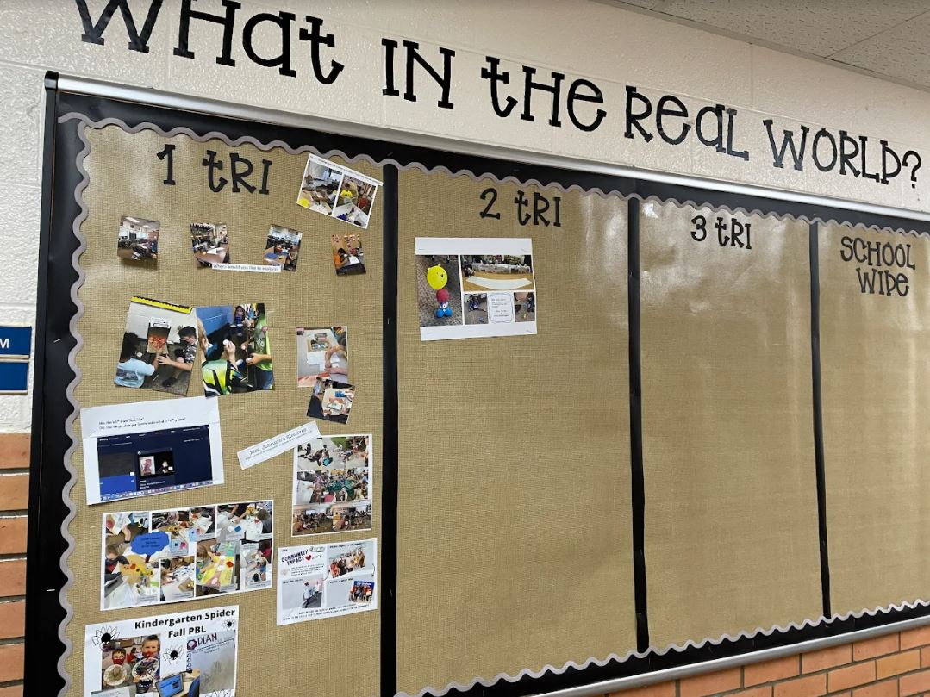

Slide 40
Lincoln Elementary Hays USD 489

Slide 41
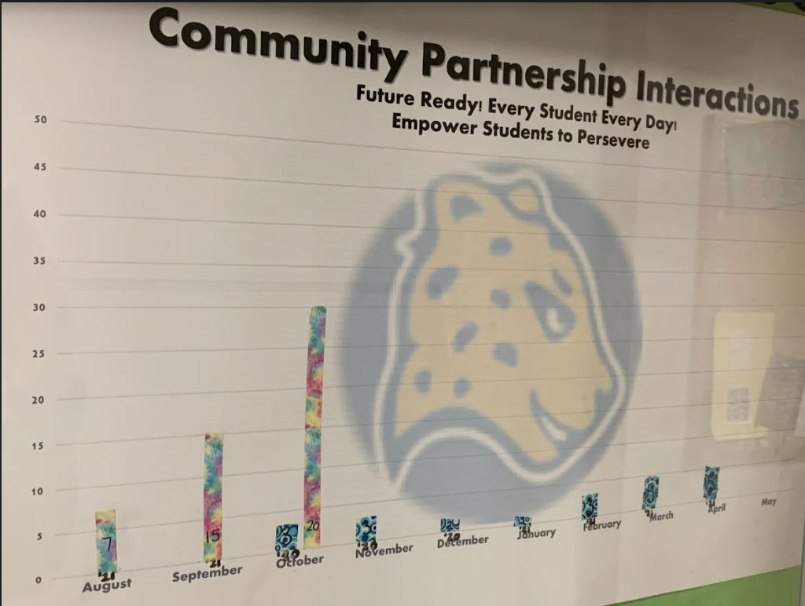

Slide 42
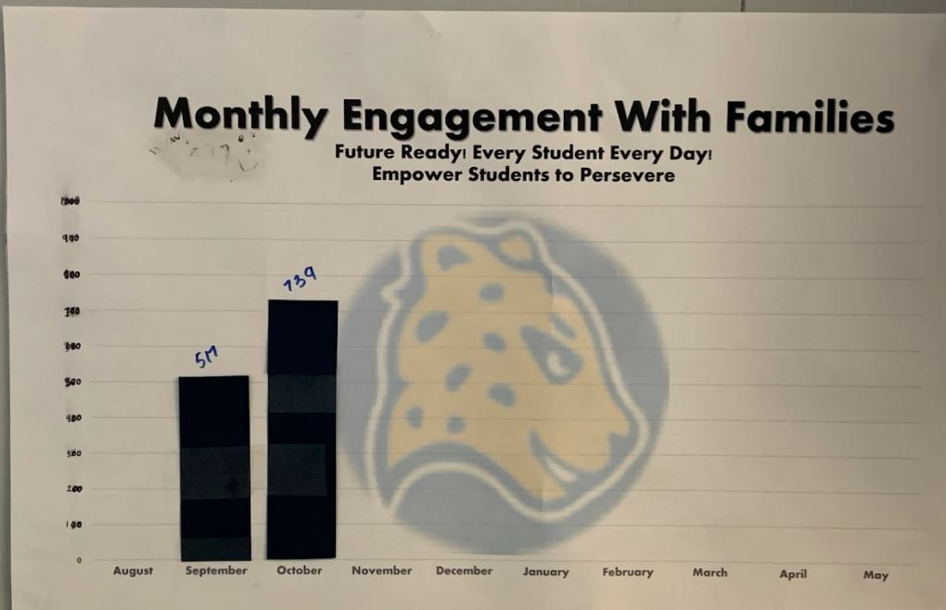

Slide 43
Lincoln Elementary School
Hutchinson USD 308

Slide 45
Remington Elementary
USD 206

Slide 46
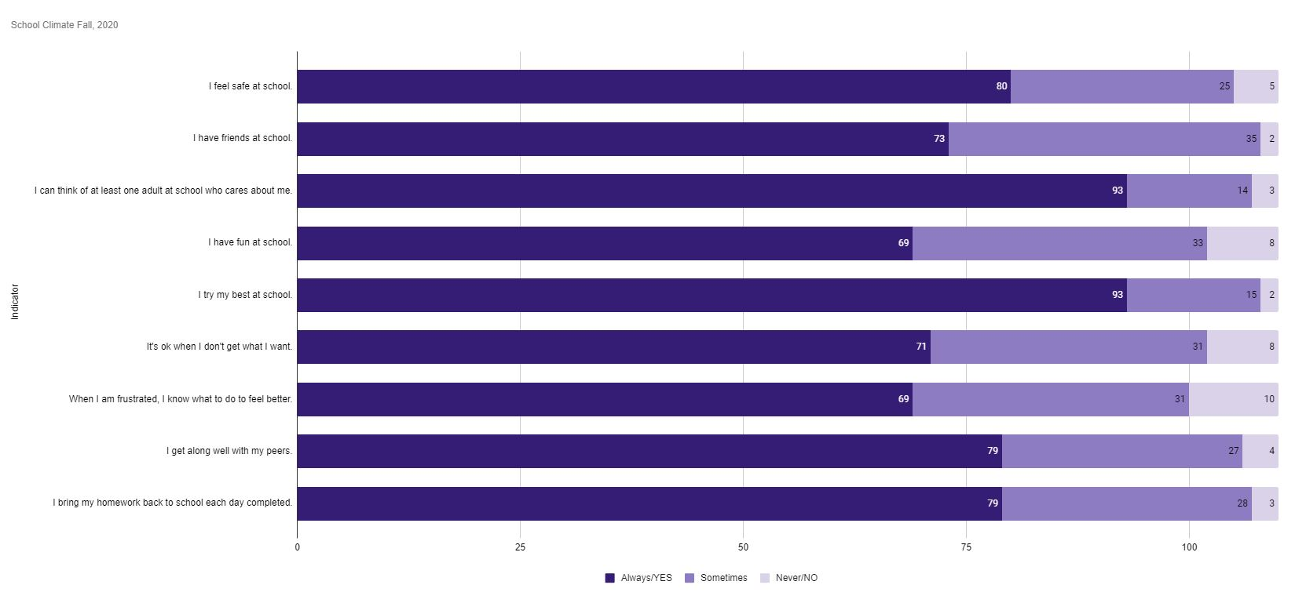

Slide 47
Burrton
USD 369

Slide 48
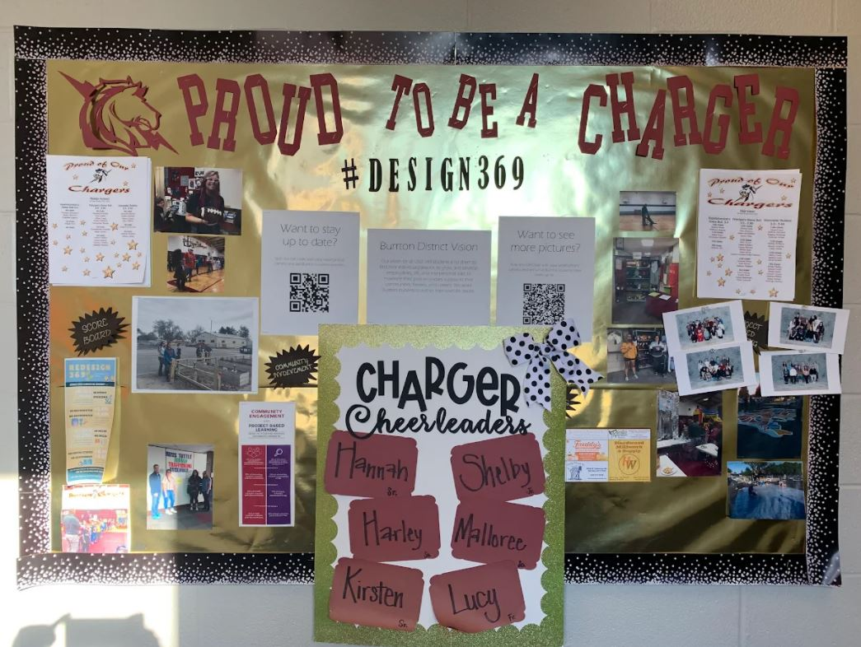

Slide 49
Bennington High School
USD 240

Slide 50
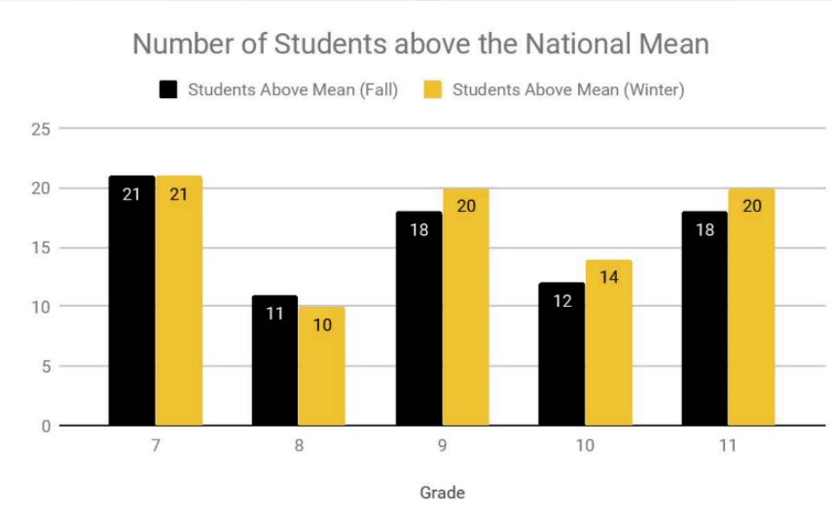

Slide 51
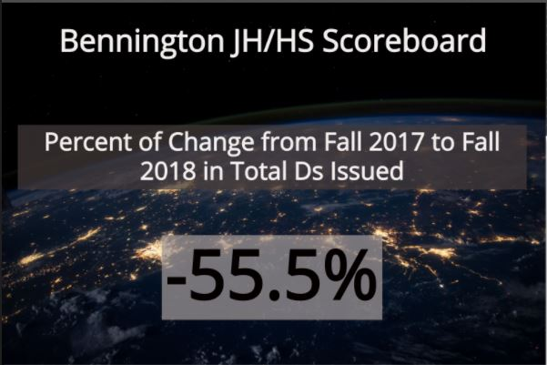
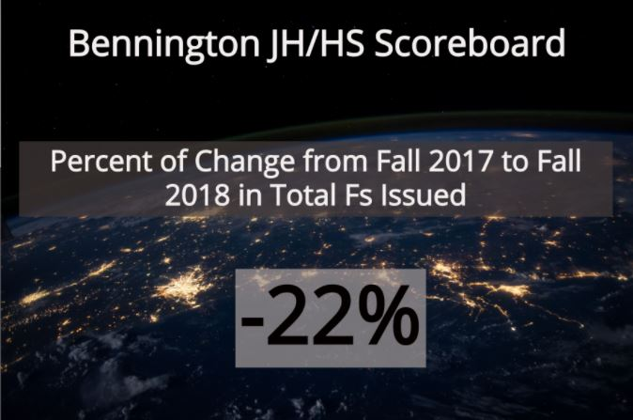

Slide 52
Hillsboro Middle/High School
USD 410

Slide 53
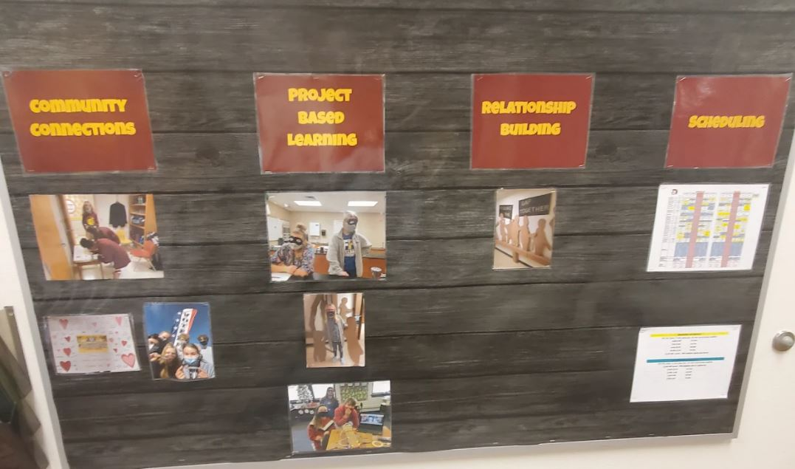

Slide 54
Ottawa High School

Slide 55
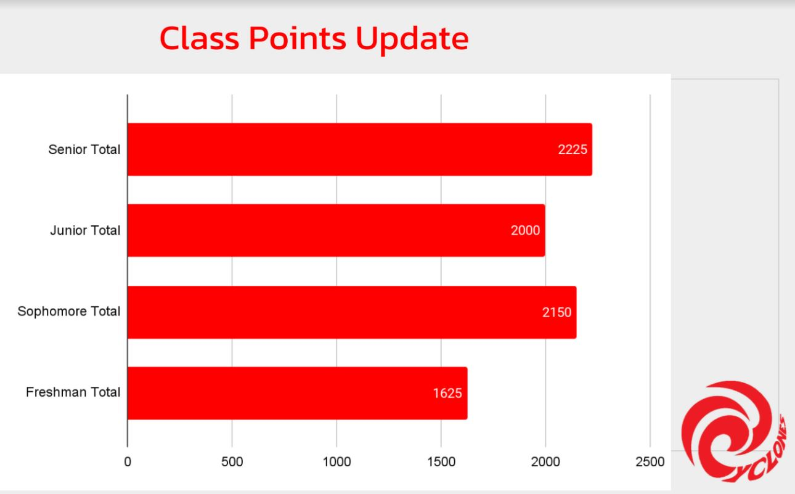

Slide 56
Minneapolis Jr/Sr High School

Slide 57
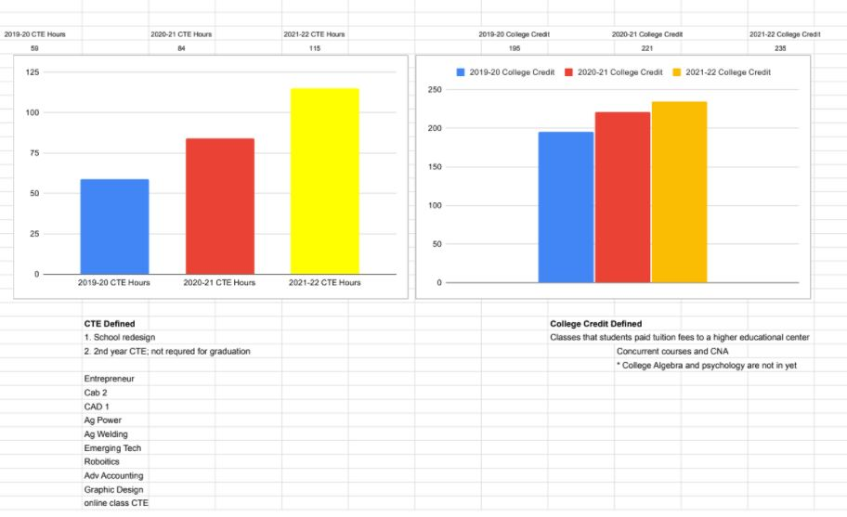

Slide 58
South Breeze Elementary (Newton)

Slide 59
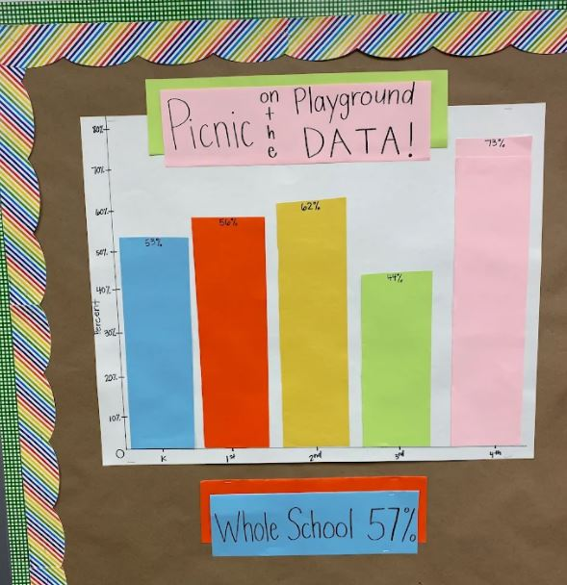

Slide 60
Redesign@ksde.org

